Slide 1
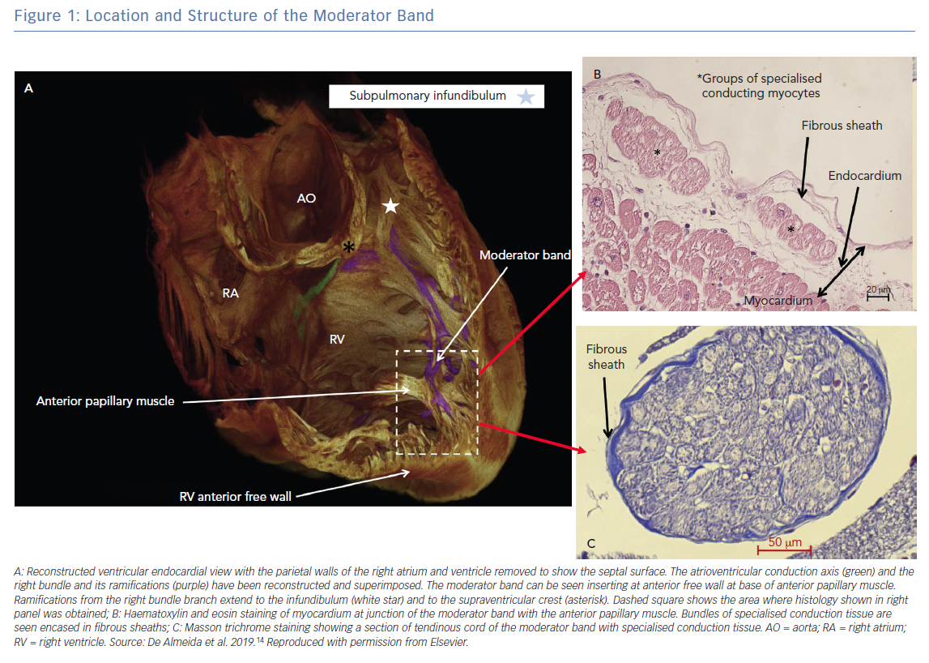
Barber M, Chinitz J, John R
Location and Structure of the Moderator Band
Citation: Arrhythmia & Electrophysiology Review 2019;8(4):294–9.
https://doi.org/10.15420/aer.2019.18

