Slide 1
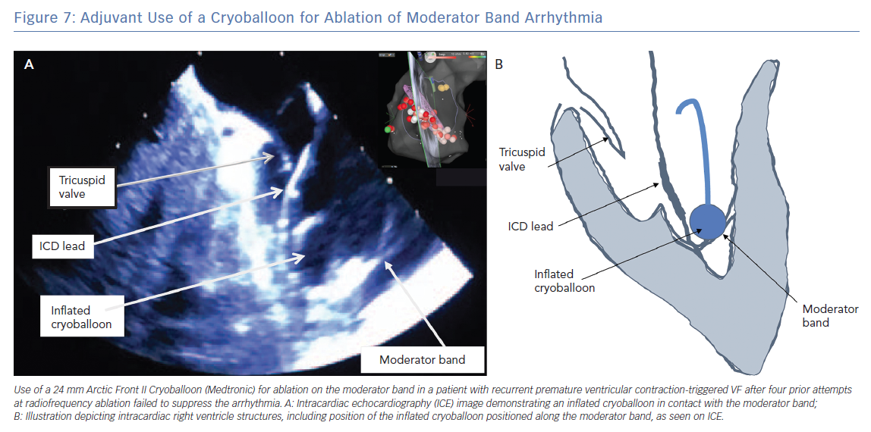
Barber M, Chinitz J, John R
Adjuvant Use of a Cryoballoon for Ablation of Moderator Band Arrhythmia
Citation: Arrhythmia & Electrophysiology Review 2019;8(4):294–9.
https://doi.org/10.15420/aer.2019.18

