Slide 1

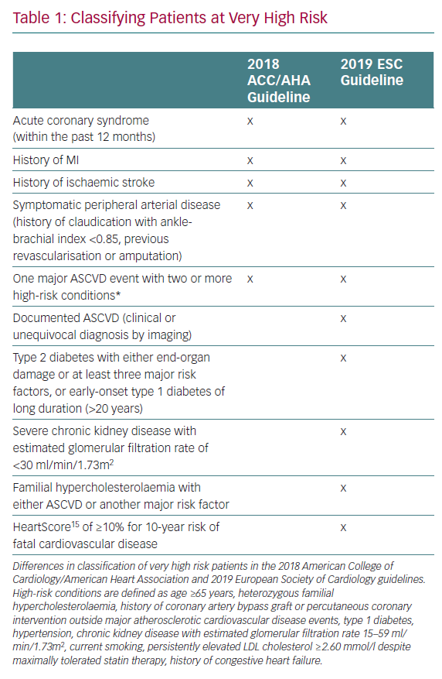
Agarwala A, Shapiro MD
Classifying Patients at Very High Risk
Citation: European Cardiology Review 2020;15:e05.
https://doi.org/10.15420/ecr.2019.16

