Slide 1
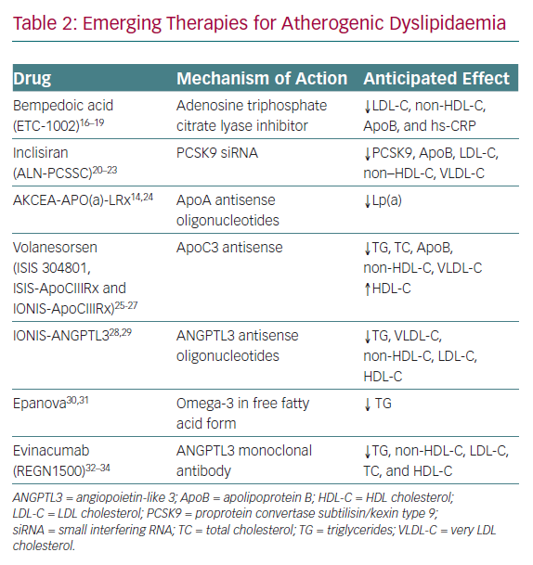
Agarwala A, Shapiro MD
Emerging Therapies for Atherogenic Dyslipidaemia
Citation: European Cardiology Review 2020;15:e05.
https://doi.org/10.15420/ecr.2019.16

