Slide 1
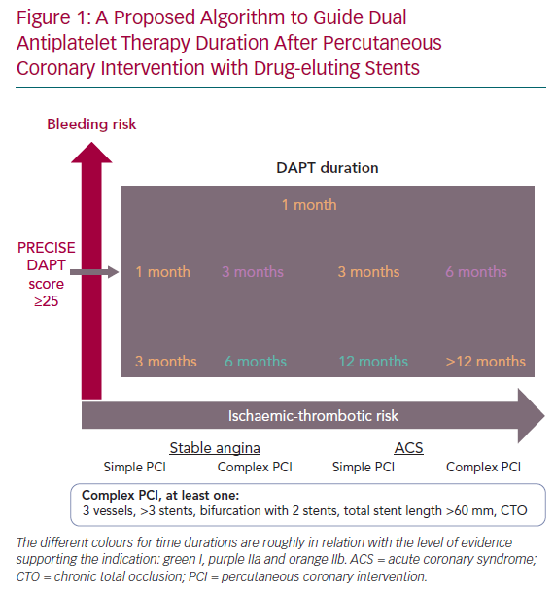
Camarero TG, de la Torre Hernández JM
A Proposed Algorithm to Guide Dual Antiplatelet Therapy Duration
Citation: European Cardiology Review 2020;15:e07.
https://doi.org/10.15420/ecr.2019.25.2

