Slide 1
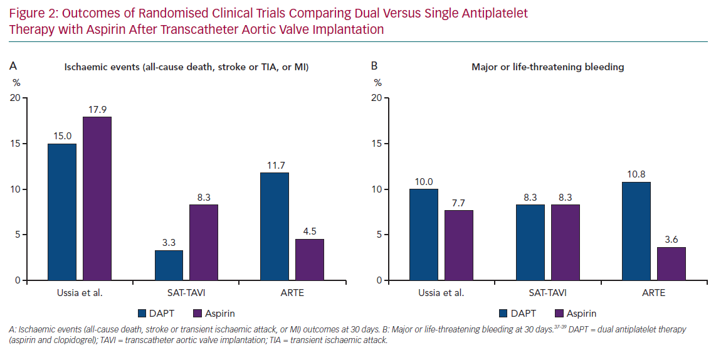
Lugo LM, Romaguera R, Gómez-Hospital JA, Ferreiro JL
Outcomes of Randomised Clinical Trials
Citation: European Cardiology Review 2020;15:e09.
https://doi.org/10.15420/ecr.2019.10

