Slide 1
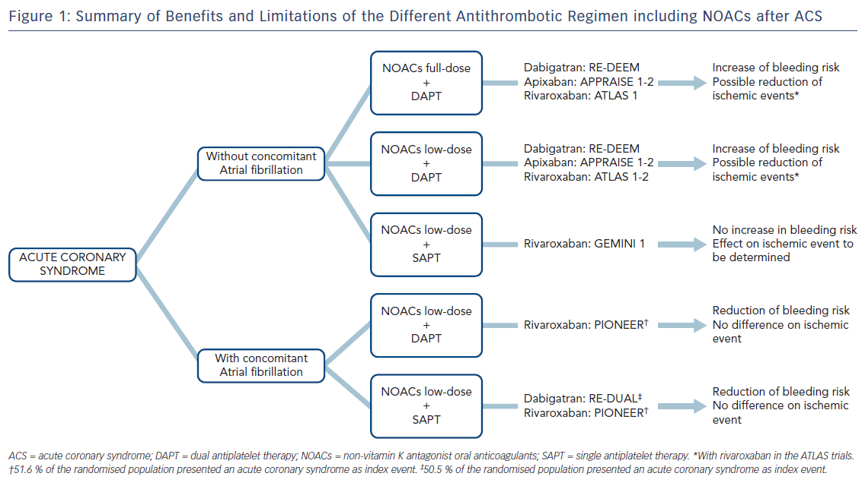
Non-Vitamin K Antagonist Oral Anticoagulant After Acute Coronary Syndrome: Is There A Role?
Citation: Interventional Cardiology Review 2018;13(2):93–8.

