Slide 1
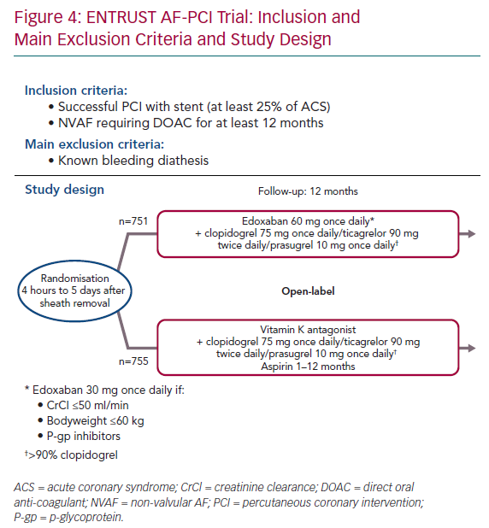
Sorbets E, Steg PG
ENTRUST AF-PCI Trial: Inclusion and Main Exclusion Criteria and Study Design
Citation: European Cardiology Review 2020;15:e10.
https://doi.org/10.15420/ecr.2018.24.2

