Slide 1
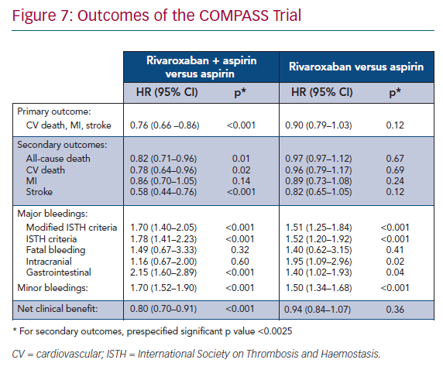
Sorbets E, Steg PG
Outcomes of the COMPASS Trial
Citation: European Cardiology Review 2020;15:e10.
https://doi.org/10.15420/ecr.2018.24.2

