Slide 1
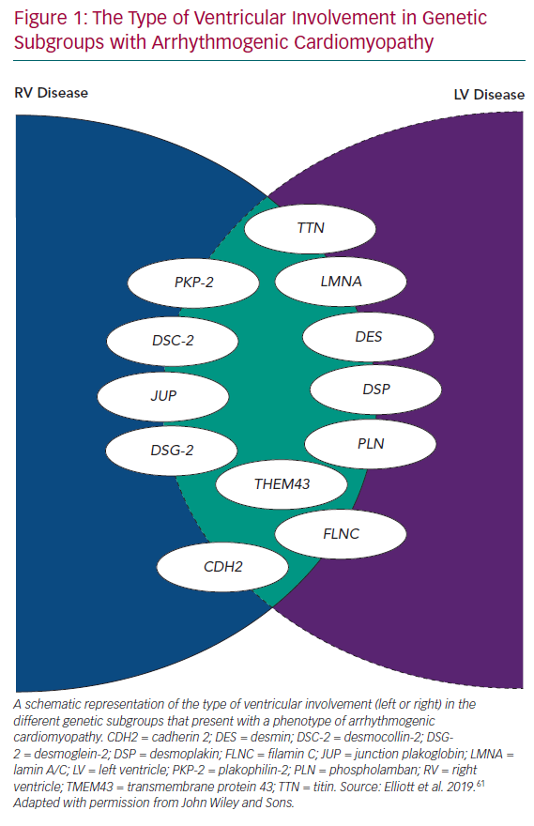
Protonotarios A, Elliott P
The Type of Ventricular Involvement in Genetic Subgroups with Arrhythmogenic Cardiomyopathy
Citation: European Cardiology Review 2020;15:e11.
https://doi.org/10.15420/ecr.2019.05

