Slide 1
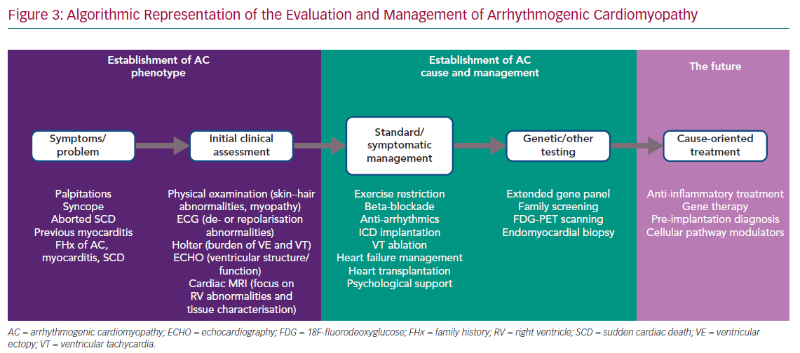
Protonotarios A, Elliott P
Algorithmic Representation of the Evaluation
Citation: European Cardiology Review 2020;15:e11.
https://doi.org/10.15420/ecr.2019.05

