Slide 1

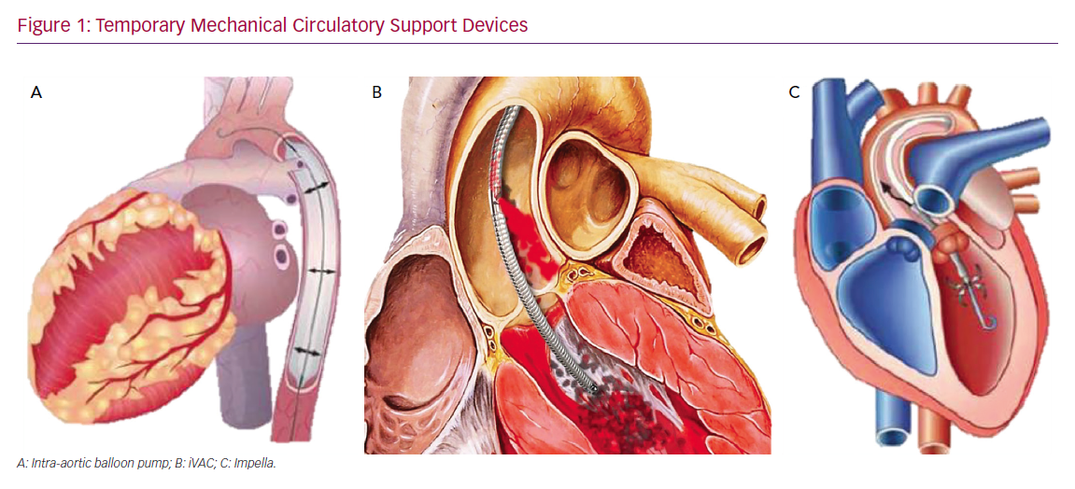
Jiritano F, Matteucci M, Fina D, Lorusso R
Temporary Mechanical Circulatory Support Devices
Citation: Cardiac Failure Review 2020;6:e01.
https://doi.org/10.15420/cfr.2019.02

