Slide 1
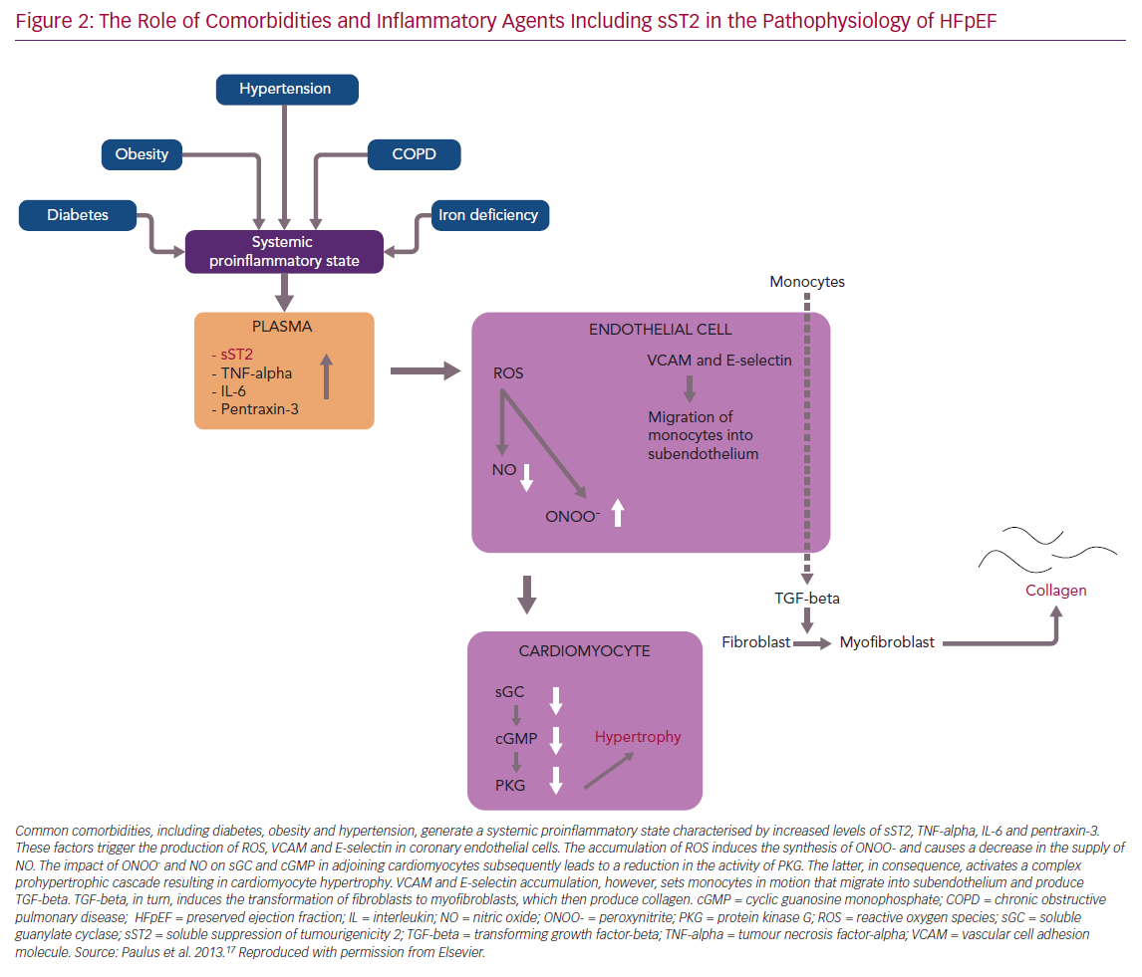
Bähr FL, Edelmann F
The Role of Comorbidities and Inflammatory
Citation: Cardiac Failure Review 2020;6:e02.
https://doi.org/10.15420/cfr.2019.10

