Slide 1
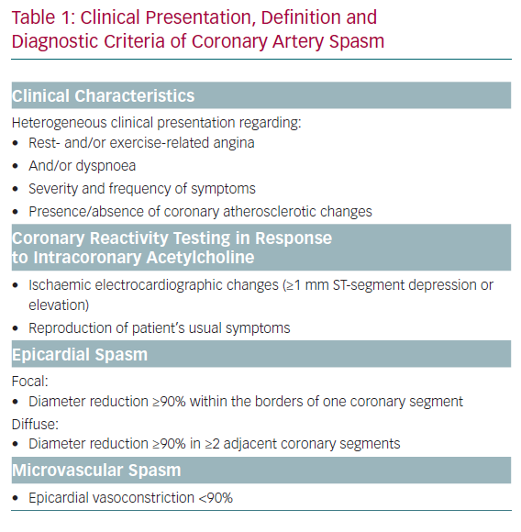
Hubert A, Seitz A, Pereyra VM, Bekeredjian R, Sechtem U, Ong P
Clinical Presentation, Definition and Diagnostic Criteria of Coronary Artery Spasm
Citation: European Cardiology Review 2020;15:e12.
https://doi.org/10.15420/ecr.2019.20

