Slide 1
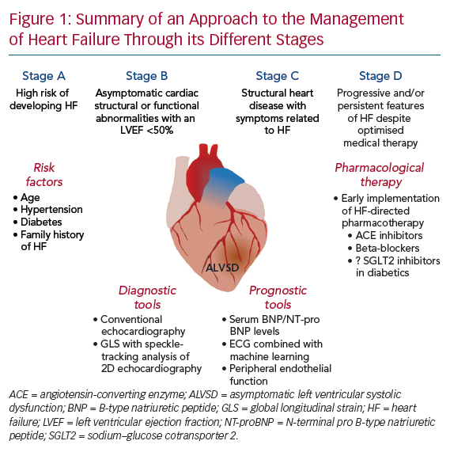
Sara JD, Toya T, Taher R, Lerman A, Gersh BJ, Anavekar NS
Summary of an Approach to the Management of Heart Failure Through its Different Stages
Citation: European Cardiology Review 2020;15:e13.
https://doi.org/10.15420/ecr.2019.14

