Slide 1
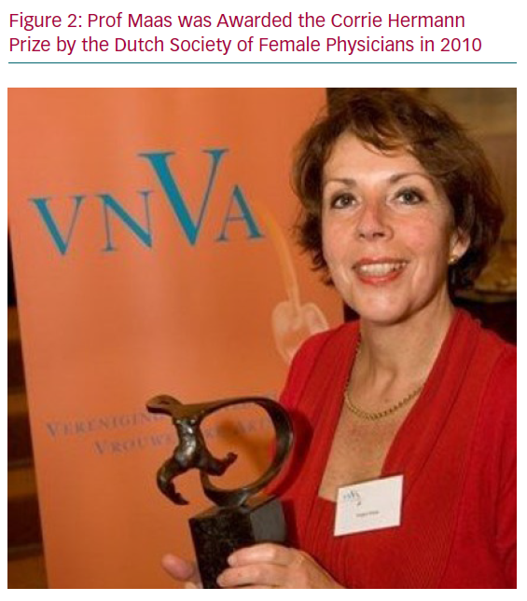
Maas AH
Prof Maas was Awarded
Citation: European Cardiology Review 2020;15:e14.
https://doi.org/10.15420/ecr.2019.19

