Slide 1
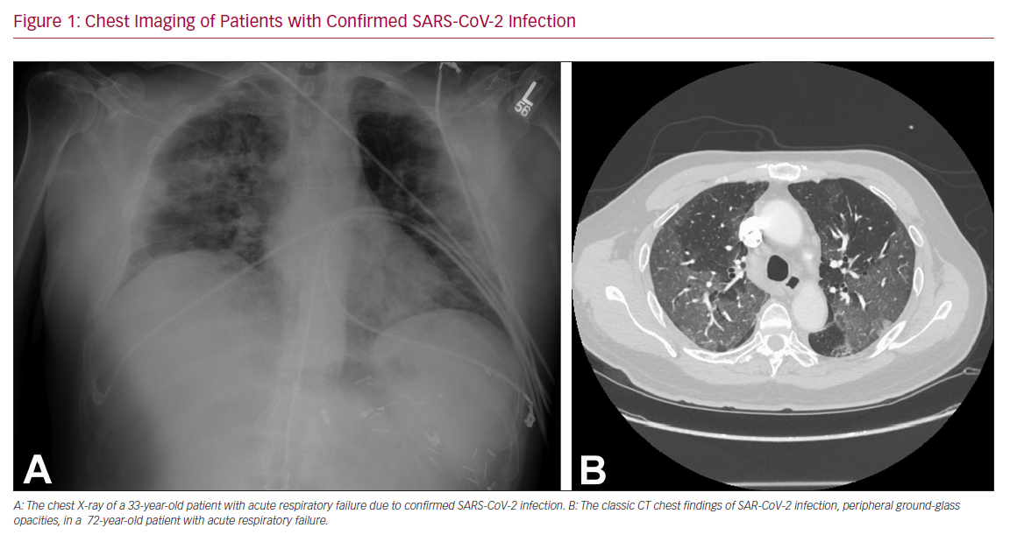
Rali AS, Sauer AJ
Chest Imaging of Patients with Confirmed SARS-CoV-2 Infection
Citation: US Cardiology Review 2020;14:e01.
https://doi.org/10.15420/usc.2020.14

