Slide 1
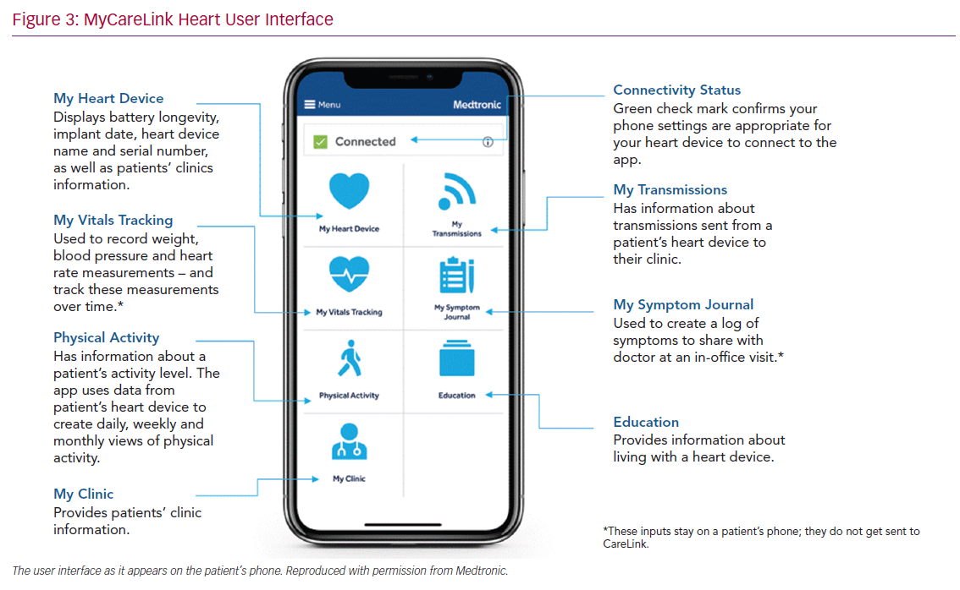
Roberts PR, ElRefai MH
MyCareLink Heart User Interface
Citation: Cardiac Failure Review 2020;6:e03.
https://doi.org/10.15420/cfr.2019.13

