Slide 1
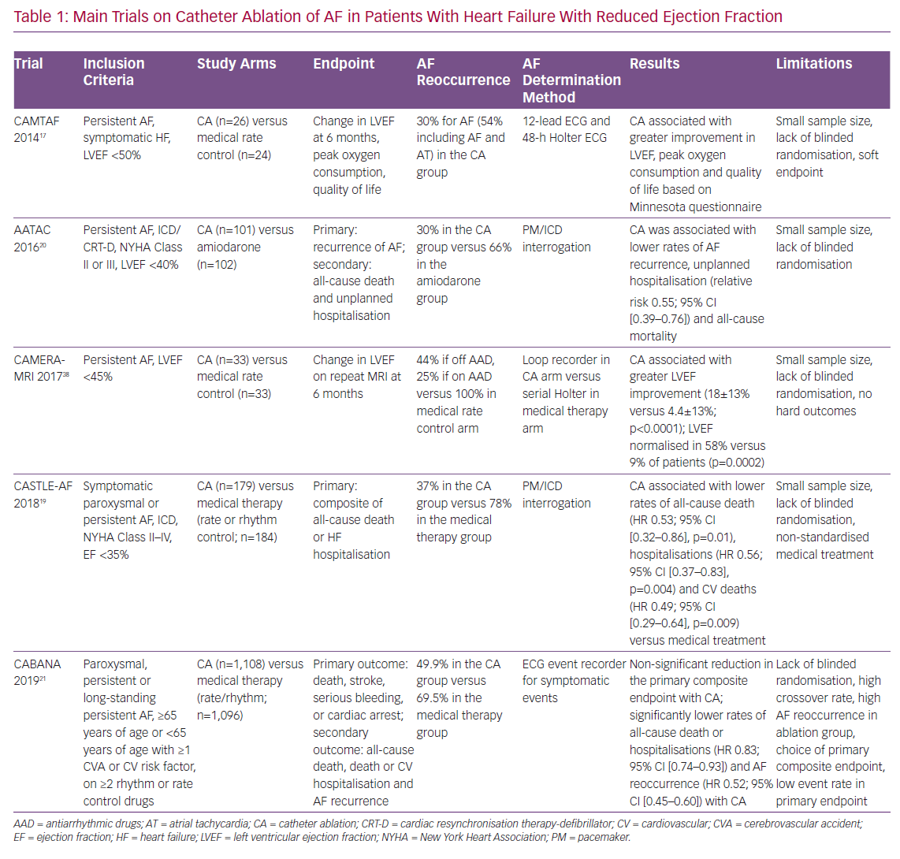
Faggioni M, Della Rocca DG, Mohanty S, Trivedi C, Gianni C, Al-Ahmad A, Horton R, Gallinghouse GJ, Burkhardt JD, Natale A
Main Trials on Catheter Ablation of AF
Citation: Cardiac Failure Review 2020;6:e04.
https://doi.org/10.15420/cfr.2019.03

