Slide 1
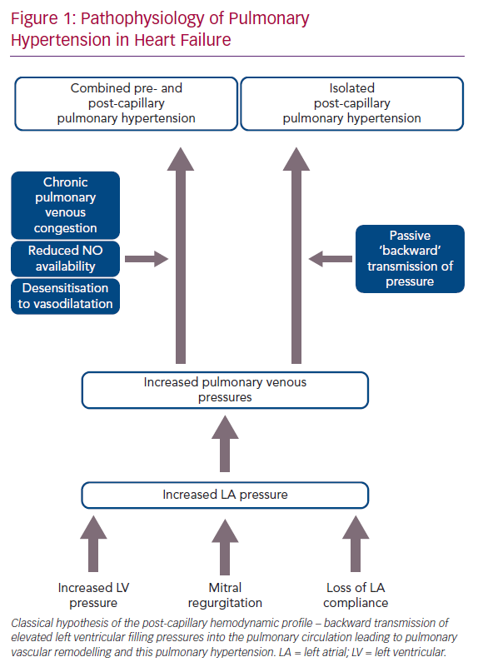
Rao SD, Adusumalli S, Mazurek JA
Pathophysiology of Pulmonary Hypertension in Heart Failure
Citation: Cardiac Failure Review 2020;6:e05.
https://doi.org/10.15420/cfr.2019.09

