Slide 1
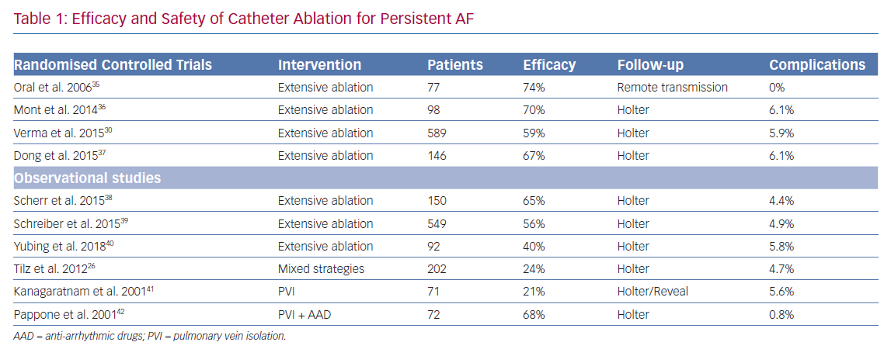
Wijesuriya N, Papageorgiou N, Maclean E, Saberwal B, Ahsan S
Efficacy and Safety of Catheter Ablation for Persistent AF
Citation: Arrhythmia & Electrophysiology Review 2020;9(1):8–14.
https://doi.org/10.15420/aer.2019.06

