Slide 1

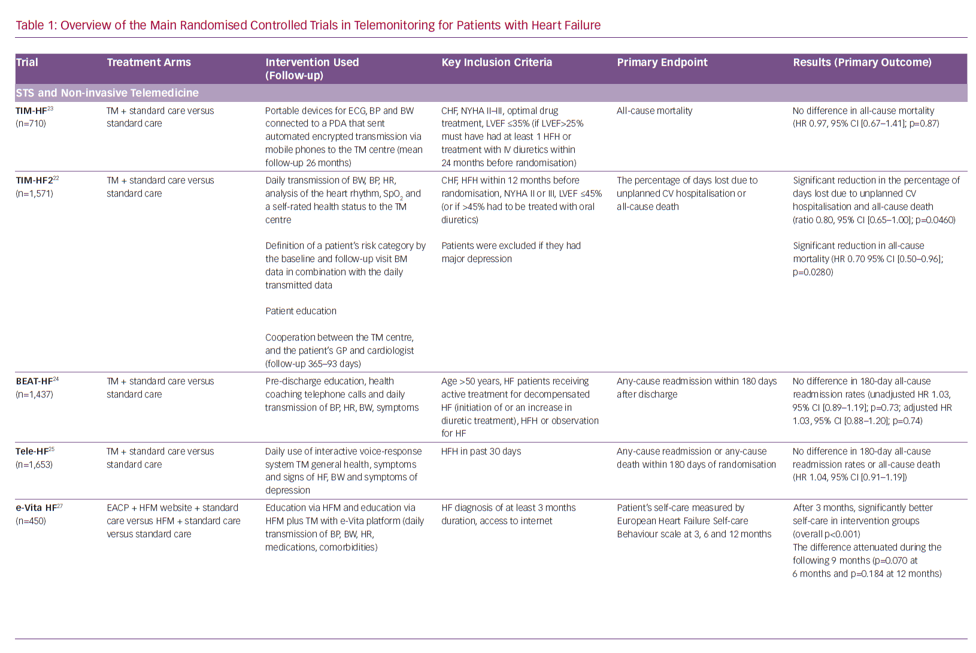
Planinc I, Milicic D, Cikes M
Overview of the Main Randomised
Citation: Cardiac Failure Review 2020;6:e06.
https://doi.org/10.15420/cfr.2019.12

