Slide 1
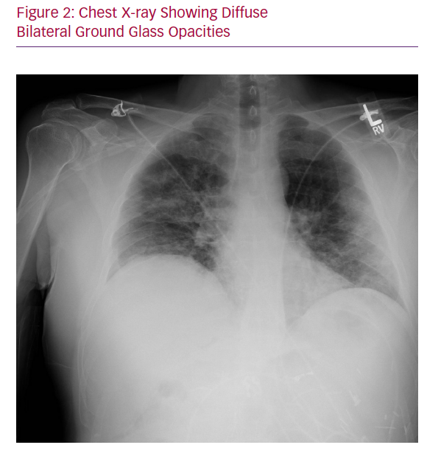
Rali AS, Nunna KR, Howard C, Herlihy JP, Guntupalli KK
Chest X-ray Showing Diffuse Bilateral Ground Glass Opacities
Citation: Cardiac Failure Review 2020;6:e08.
https://doi.org/10.15420/cfr.2020.06

