Slide 1
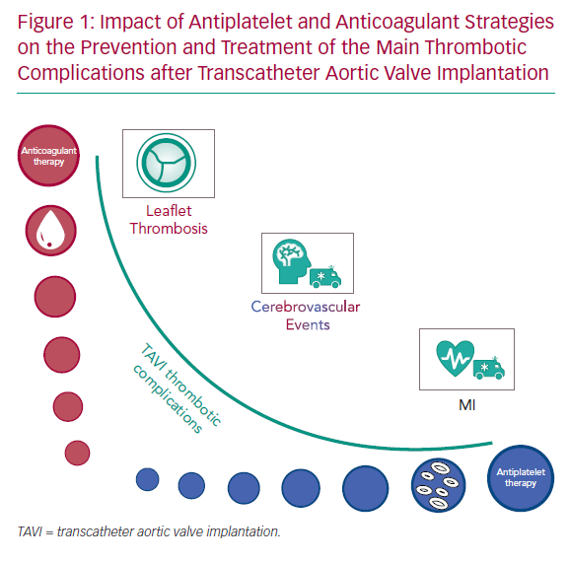
Greco A, Capodanno D
Impact of Antiplatelet and Anticoagulant Strategies
Citation: Interventional Cardiology Review 2020;15:e02.
https://doi.org/10.15420/icr.2019.24

