Slide 1
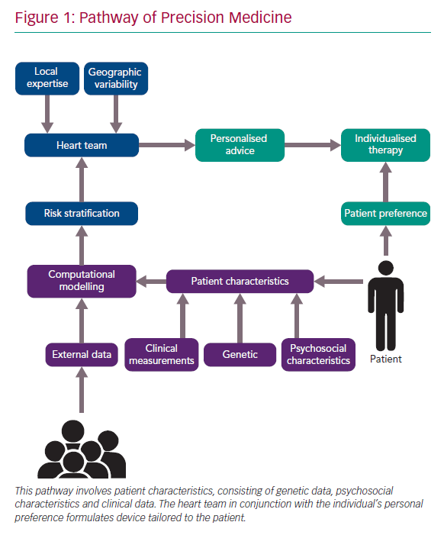
Hokken TW, Ribeiro JM, De Jaegere PP, Van Mieghem NM
Pathway of Precision Medicine
Citation: Interventional Cardiology Review 2020;15:e03.
https://doi.org/10.15420/icr.2019.23

