Slide 1
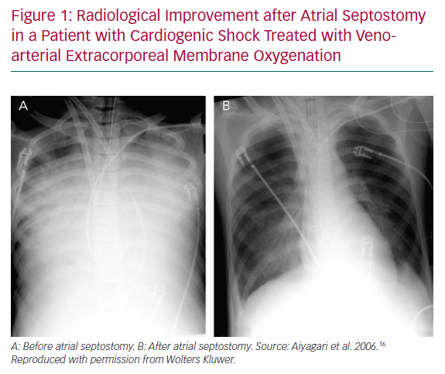
Guimaraes L, del Val D, Bergeron S, O’Connor K, Bernier M, Rodés-Cabau J
Radiological Improvement after Atrial Septostomy in a Patient
Citation: European Cardiology Review 2020;15:e18.
https://doi.org/10.15420/ecr.2019.04

