Slide 1
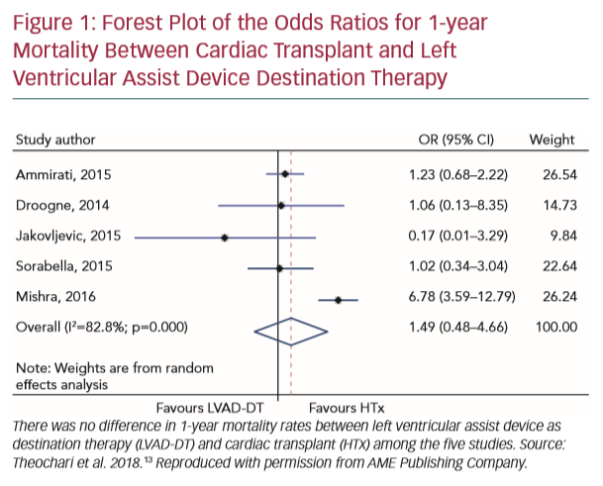
Bayés-Genís A, Muñoz-Guijosa C, Santiago-Vacas E, Montero S, García-García C, Codina P, Núñez J, Lupón J
Forest Plot of the Odds Ratios for 1-year Mortality
Citation: European Cardiology Review 2020;15:e19.
https://doi.org/10.15420/ecr.2019.29.2

