Slide 1
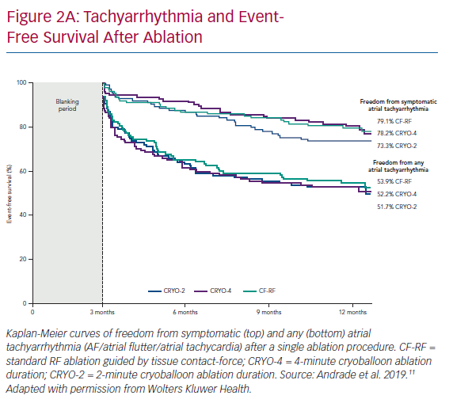
Andrade JG, Verma A, Macle L, Deyell MW, Khairy P
Tachyarrhythmia and EventFree Survival After Ablation
Citation: Arrhythmia & Electrophysiology Review 2020;9(1):34–9.
https://doi.org/10.15420/aer.2019.13

