Slide 1
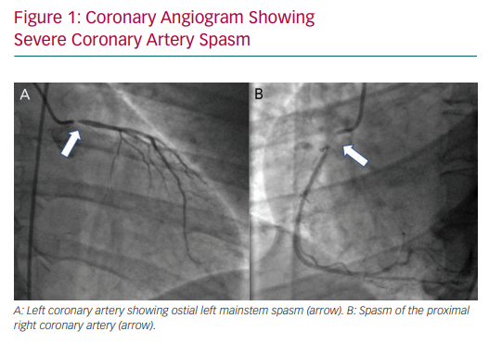
Gue YX, Kanji R, Gati S, Gorog DA
Coronary Angiogram Showing Severe Coronary Artery Spasm
Citation: European Cardiology Review 2020;15:e20.
https://doi.org/10.15420/ecr.2019.13

