Slide 1
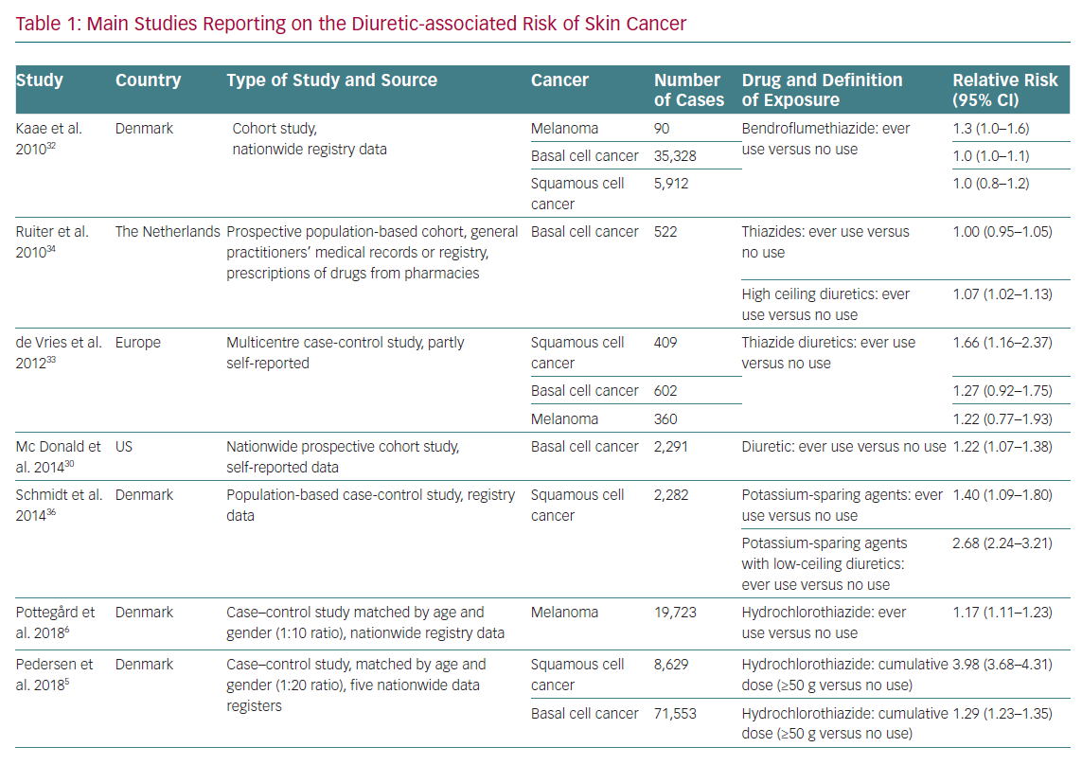
Battistoni A, Volpe M
Main Studies Reporting on the Diuretic-associated Risk of Skin Cancer
Citation: European Cardiology Review 2020;15:e21.
https://doi.org/10.15420/ecr.2019.21

