Slide 1
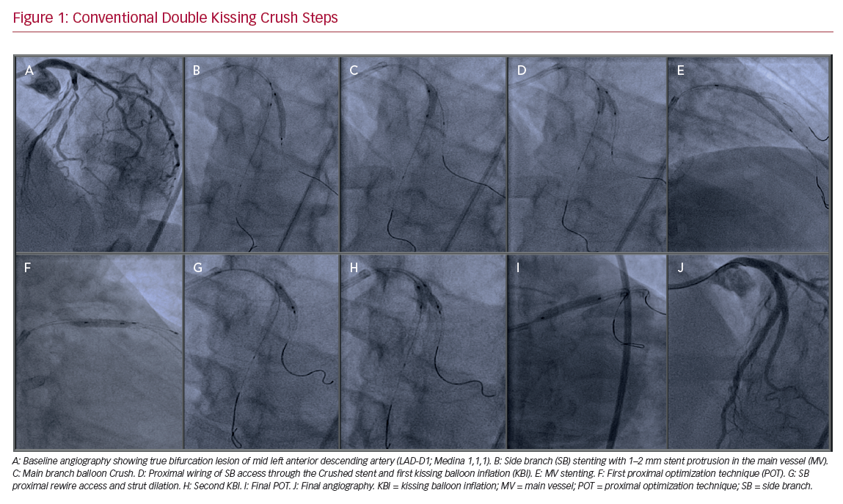
Lavarra F
Conventional Double Kissing Crush Steps
Citation: US Cardiology Review 2020;14:e02.
https://doi.org/10.15420/usc.2020.07

