Slide 1
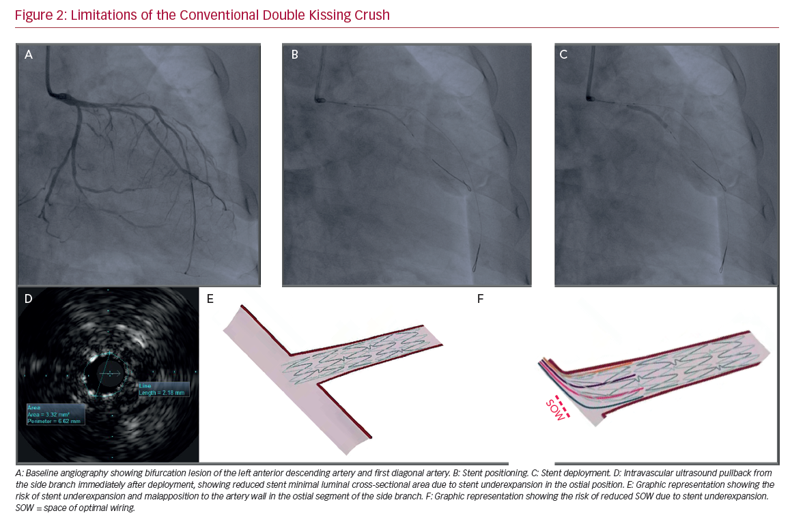
Lavarra F
Limitations of the Conventional Double Kissing Crush
Citation: US Cardiology Review 2020;14:e02.
https://doi.org/10.15420/usc.2020.07

