Slide 1
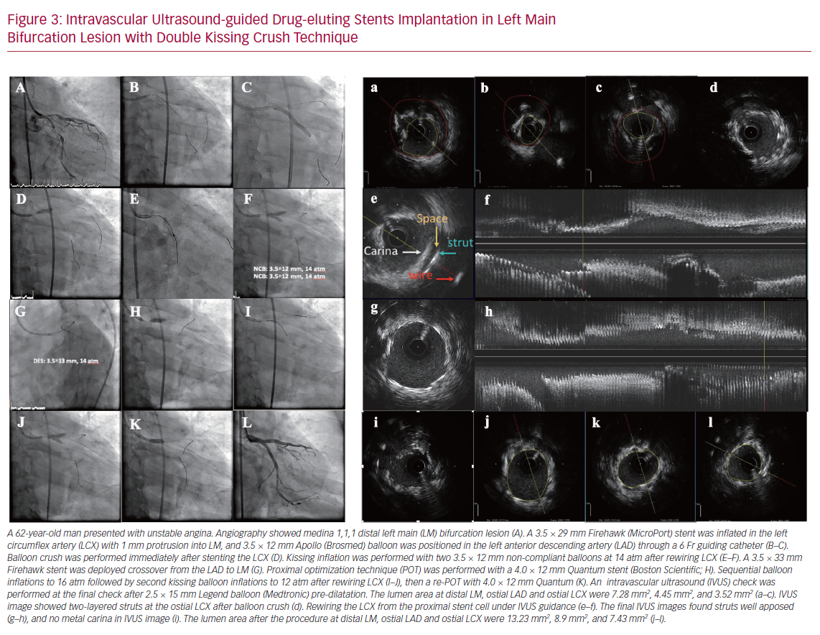
Gao XF, Kong XQ, Zuo GF, Wang ZM, Ge Z, Zhang JJ
Intravascular Ultrasound-guided Drug-eluting Stents Implantation
Citation: US Cardiology Review 2020;14:e03.
https://doi.org/10.15420/usc.2020.03

