Slide 1
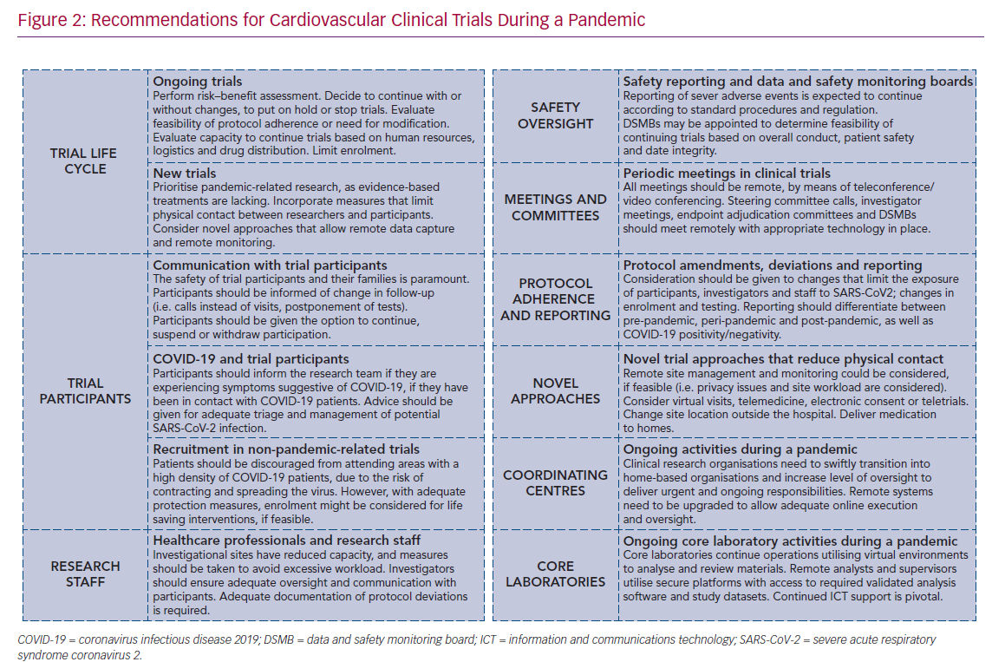
Spitzer E, Ren B, Brugts JJ, Daemen J, McFadden E, Tijssen JG, Van Mieghem NM
Recommendations for Cardiovascular Clinical Trials During a Pandemic
Citation: Cardiac Failure Review 2020;6:e09.
https://doi.org/10.15420/cfr.2020.07

