Slide 1
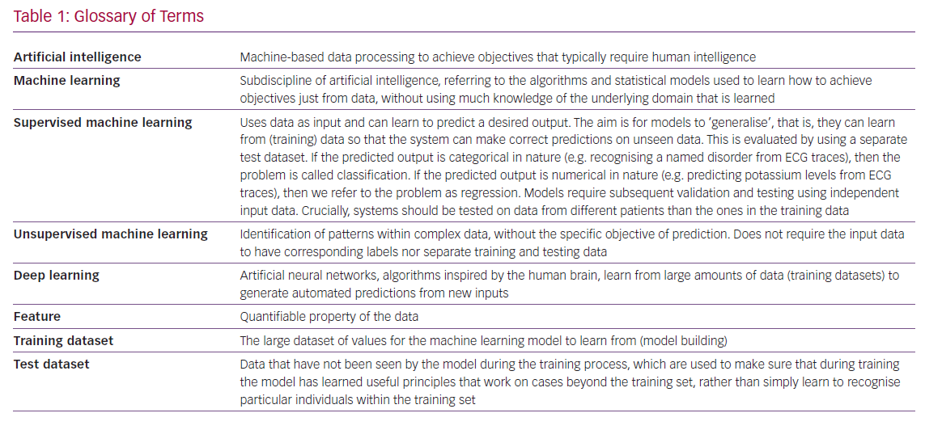
Bachtiger P, Plymen CM, Pabari PA, Howard JP, Whinnett Z, Opoku F, Janering S, Faisal AA, Francis DP, Peters NS
Glossary of Terms
Citation: Cardiac Failure Review 2020;6:e11.
https://doi.org/10.15420/cfr.2019.14

