Slide 1
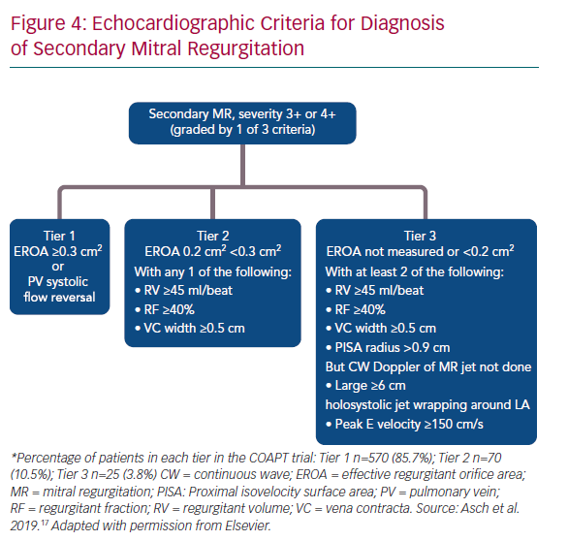
Goel K, Barker CM, Lindenfeld J
Echocardiographic Criteria for Diagnosis of Secondary Mitral Regurgitation
Citation: European Cardiology Review 2020;15:e22.
https://doi.org/10.15420/ecr.2019.08

