Slide 1
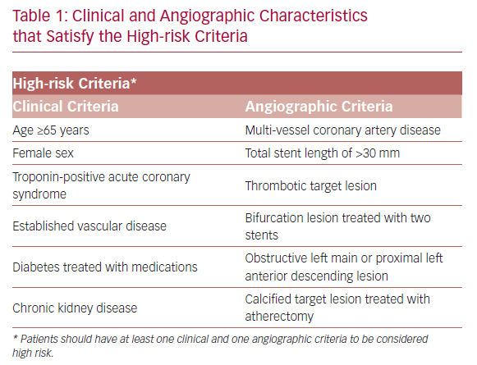
Nicolas J, Baber U, Mehran R
Clinical and Angiographic Characteristics that Satisfy the High-risk Criteria
Citation: US Cardiology Review 2020;14:e04.
https://doi.org/10.15420/usc.2019.02

