Slide 1
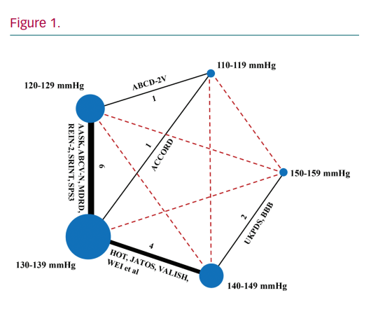
Cheung BMY, Fei Y, Tsoi M
Network Meta-analysis to Determine
Citation: European Cardiology Review 2020;15:e24.
https://doi.org/10.15420/ecr.2020.15.1.PO1

