Slide 1
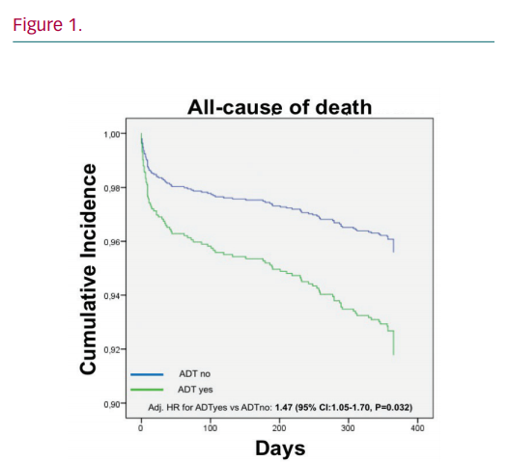
Denegri A, Raeber L, Windecker S, Gencer B, Mach F, Rodondi N, Heg D, Nanchen D, Matter C, Luescher T
The Perilousness of Antidepressant Drugs
Citation: European Cardiology Review 2020;15:e26.
https://doi.org/10.15420/ecr.2020.15.1.PO3

