Slide 1
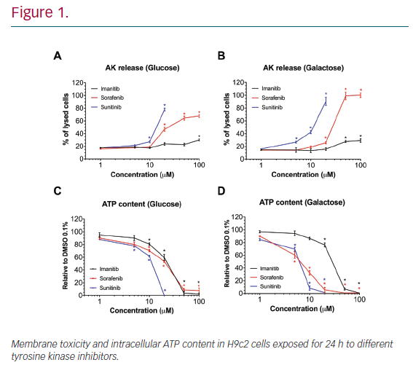
Bouitbir J, Alshaikhali A, Panajatovic M, Abegg V, Paech F, Krähenbühl S
Mechanisms of Cardiotoxicity Associated
Citation: European Cardiology Review 2020;15:e33.
https://doi.org/10.15420/ecr.2020.15.1.PO10

