Slide 1

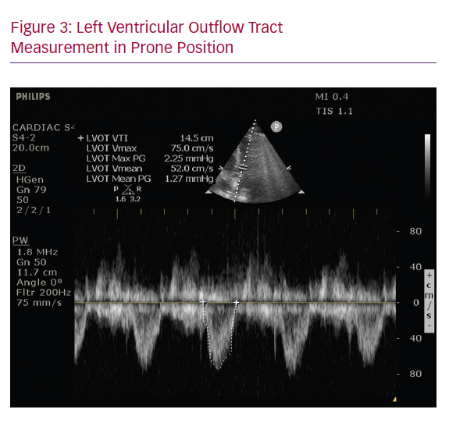
Rali AS, Trevino S, Yang E, Herlihy JP, Diaz-Gomez J
Left Ventricular Outflow Tract Measurement in Prone Position
Citation: Cardiac Failure Review 2020;6:e12.
https://doi.org/10.15420/cfr.2020.12

