Slide 1
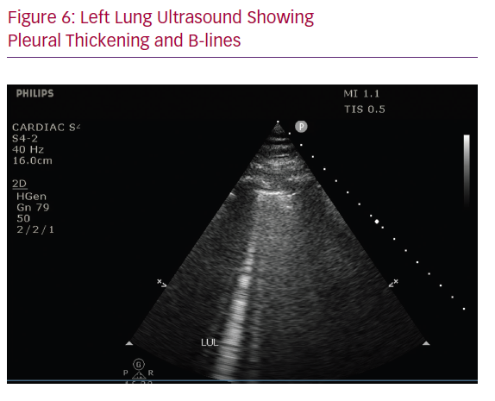
Rali AS, Trevino S, Yang E, Herlihy JP, Diaz-Gomez J
Left Lung Ultrasound Showing Pleural Thickening and B-lines
Citation: Cardiac Failure Review 2020;6:e12.
https://doi.org/10.15420/cfr.2020.12

