Slide 1
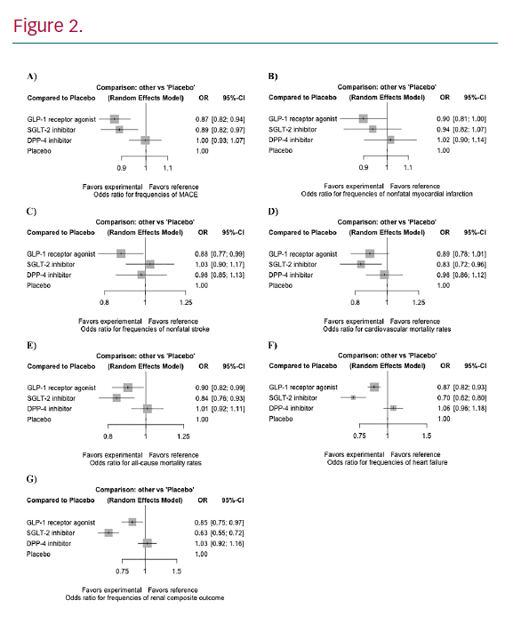
Cheung BMY, Fei Y, Tsoi M
Cardiovascular Benefits of New Antidiabetic Drug Classes
Citation: European Cardiology Review 2020;15:e40.
https://doi.org/10.15420/ecr.2020.15.1.PO17

