Slide 1
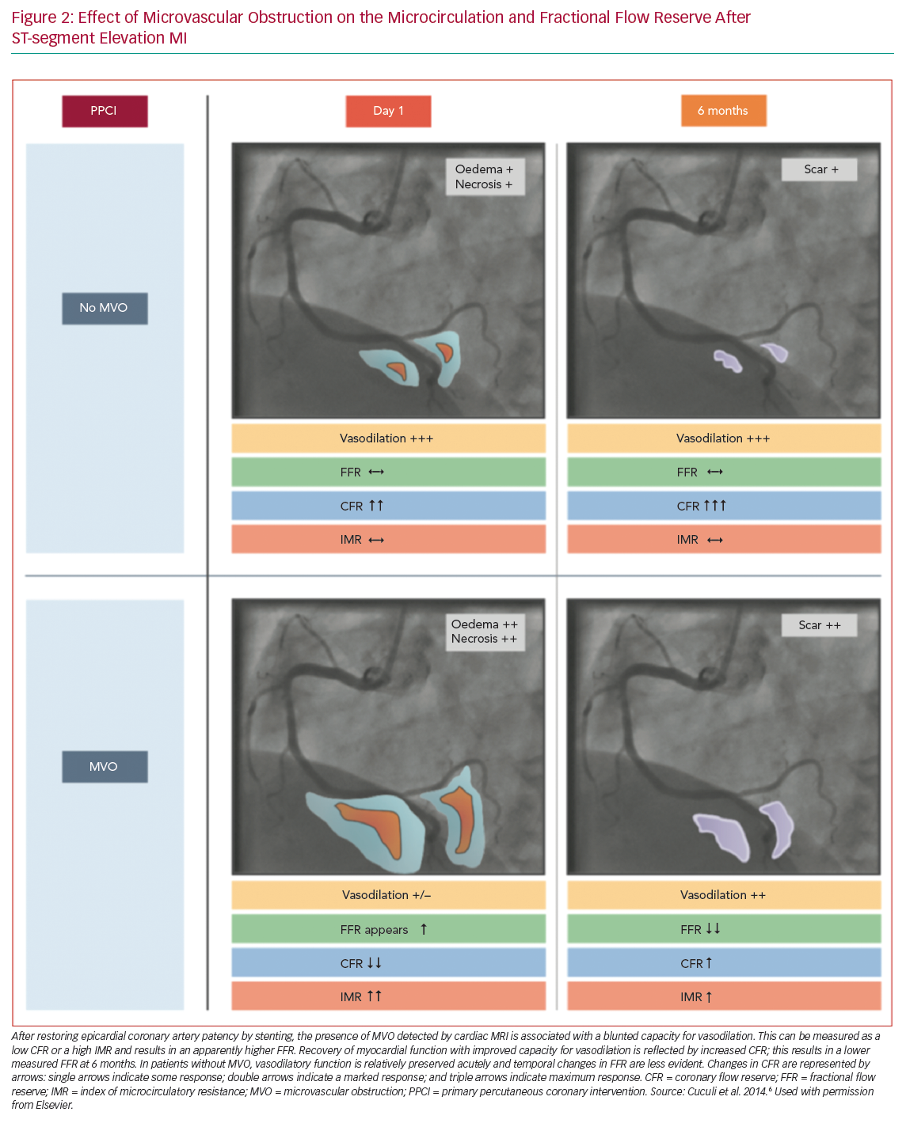
Why, When And How Should Clinicians Use Physiology In Patients With Acute Coronary Syndromes?
Citation: Interventional Cardiology Review 2020;15:e05.
https://doi.org/10.15420/icr.2019.26

