Slide 1
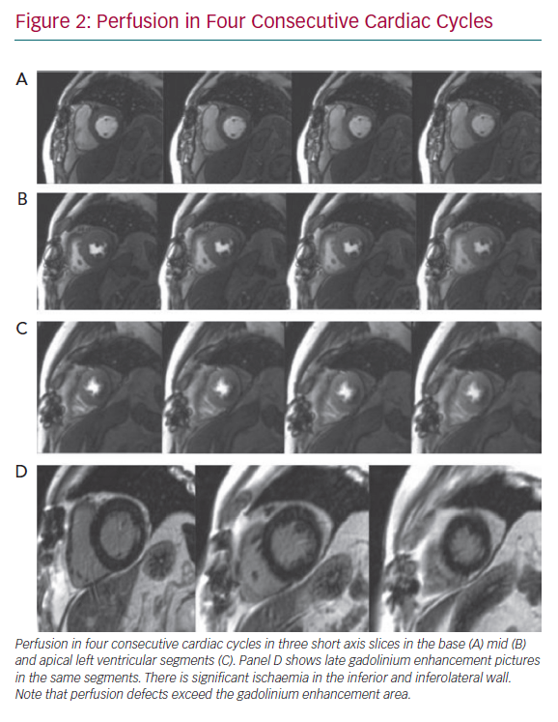
Kolentinis M, Le M, Nagel E, Puntmann VO
Perfusion in Four Consecutive Cardiac Cycles
Citation: European Cardiology Review 2020;15:e50.
https://doi.org/10.15420/ecr.2019.17

