Slide 1
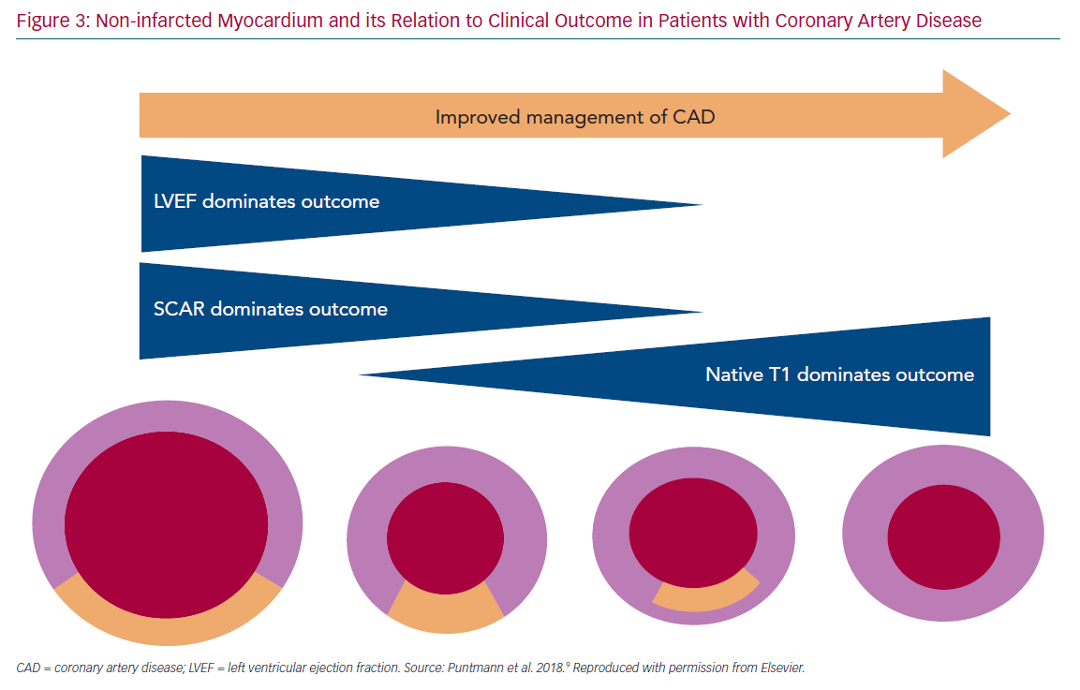
Kolentinis M, Le M, Nagel E, Puntmann VO
Non-infarcted Myocardium and its Relation
Citation: European Cardiology Review 2020;15:e50.
https://doi.org/10.15420/ecr.2019.17

