Slide 1
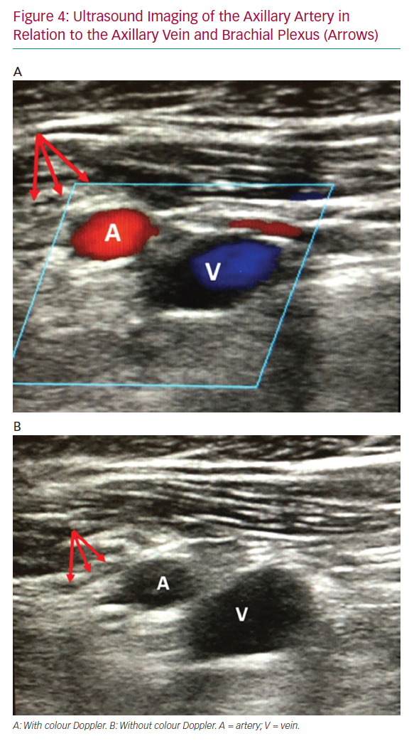
Dawson K, Jones TL, Kearney KE, McCabe JM
Ultrasound Imaging of the Axillary Artery
Citation: Interventional Cardiology Review 2020;15:e07.
https://doi.org/10.15420/icr.2019.22

