Slide 1

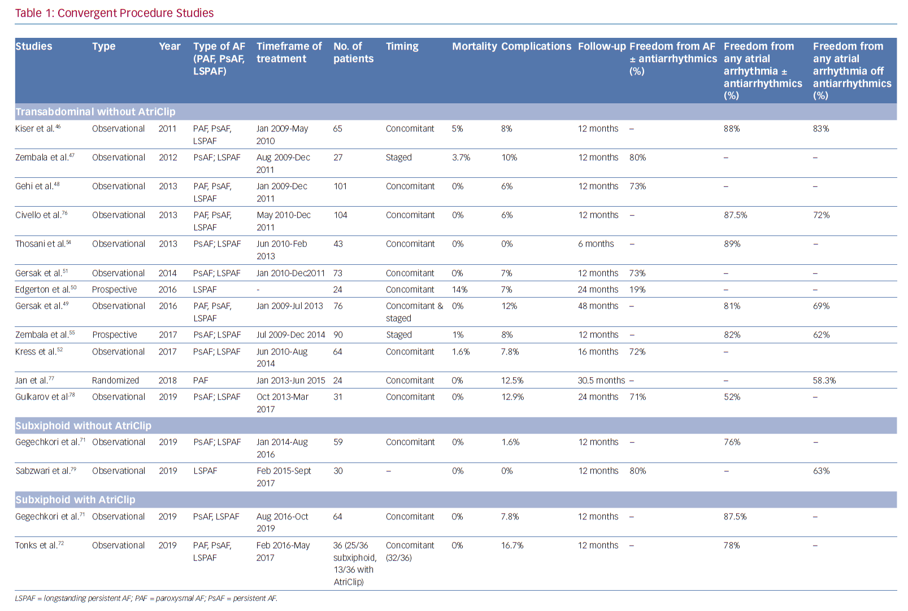
Wats K, Kiser A, Makati K, Sood N, DeLurgio D, Greenberg Y, Yang F
Convergent Procedure Studies
Citation: Arrhythmia & Electrophysiology Review 2020;9(2):88–96.
https://doi.org/10.15420/aer.2019.20

