Slide 1
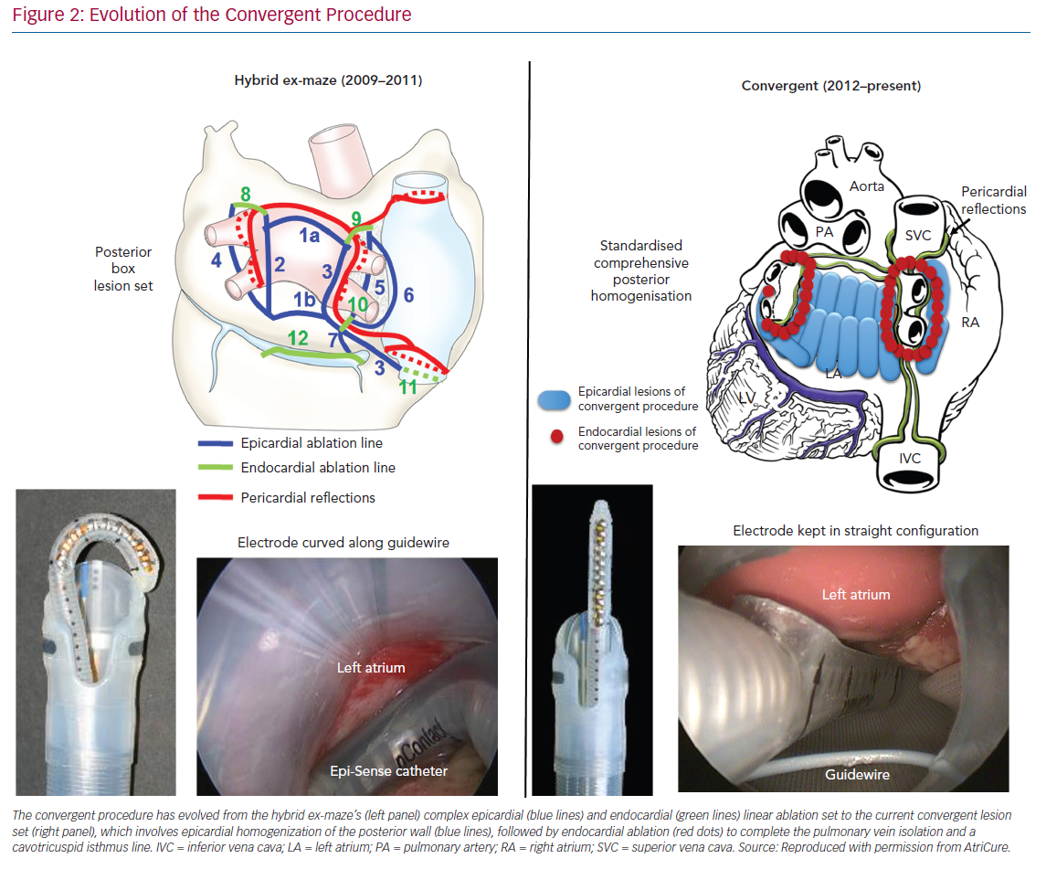
Wats K, Kiser A, Makati K, Sood N, DeLurgio D, Greenberg Y, Yang F
Evolution of the Convergent Procedure
Citation: Arrhythmia & Electrophysiology Review 2020;9(2):88–96.
https://doi.org/10.15420/aer.2019.20

