Slide 1
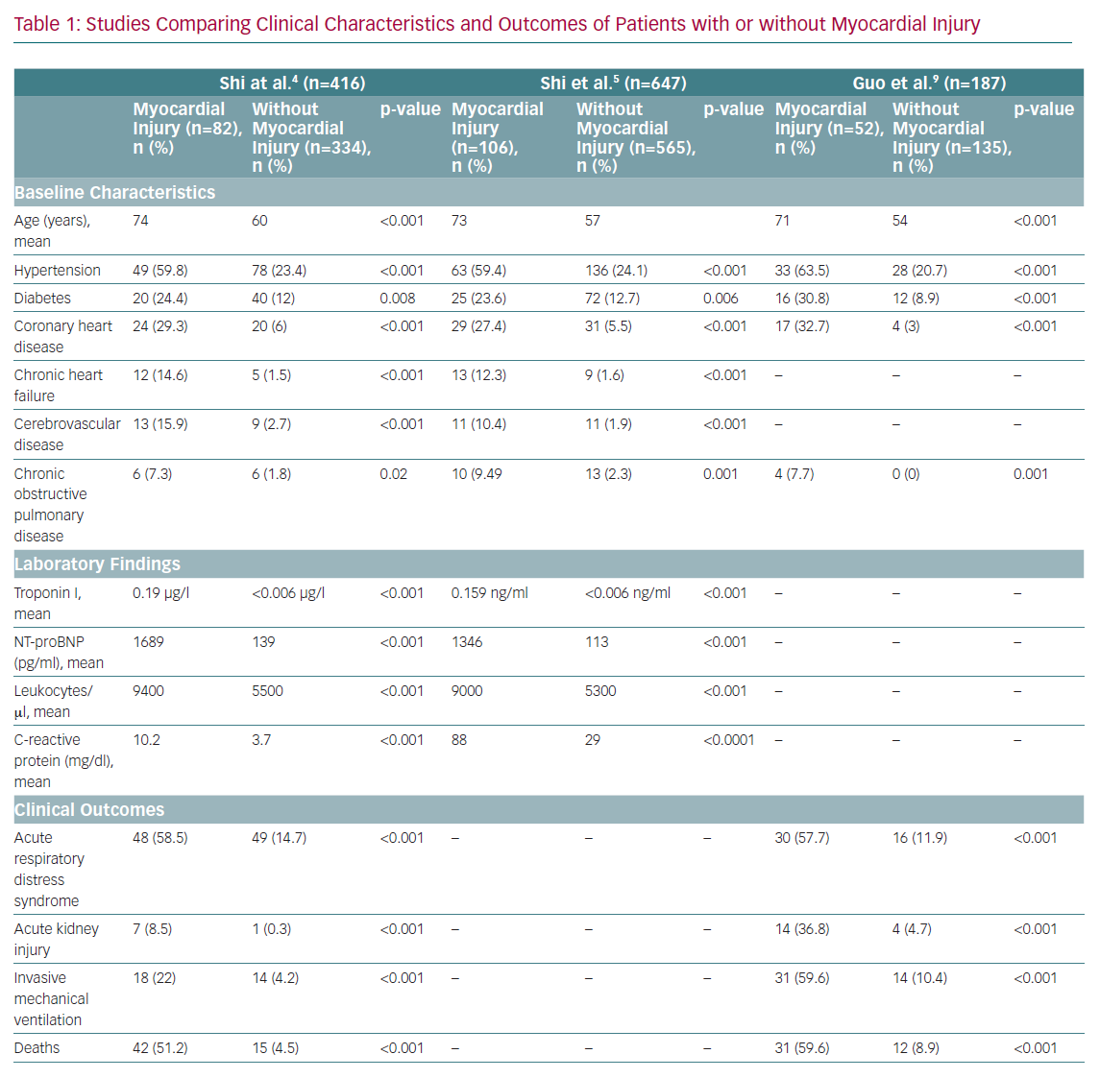
Montone RA, Iannaccone G, Meucci MC, Gurgoglione F, Niccoli G
Studies Comparing Clinical Characteristics
Citation: European Cardiology Review 2020;15:e52.
https://doi.org/10.15420/ecr.2020.22

